Slide 1
EECS 498 System Design of a Search Engine
Winter 2026
Lecture 7: Memory-mapped hash tables
Nicole Hamilton
https://web.eecs.umich.edu/~nham/
nham@umich.edu

Slide 2
agenda
Course details.
Mascot vote results.
Team photos.
Relocatable data structures.
Memory mapping a hash table.

Slide 3
agenda
Course details.
Mascot vote results.
Team photos.
Relocatable data structures.
Memory mapping a hash table.

Slide 4
details
Project plans details posted. Keep it short and simple.
Minor updates to a some of the AG assignments on Canvas.
Questions about homework, headers, C++ version, whatever.

Slide 5
agenda
Course details.
Mascot vote results.
Team photos.
Relocatable data structures.
Memory mapping a hash table.

Slide 6
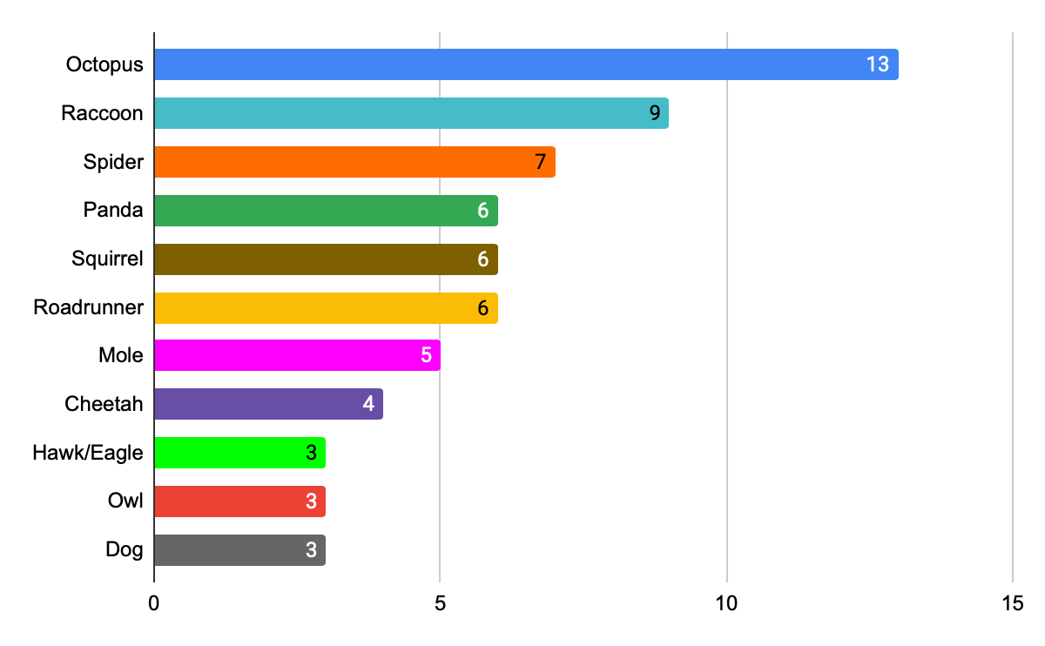
First Choice

Slide 7
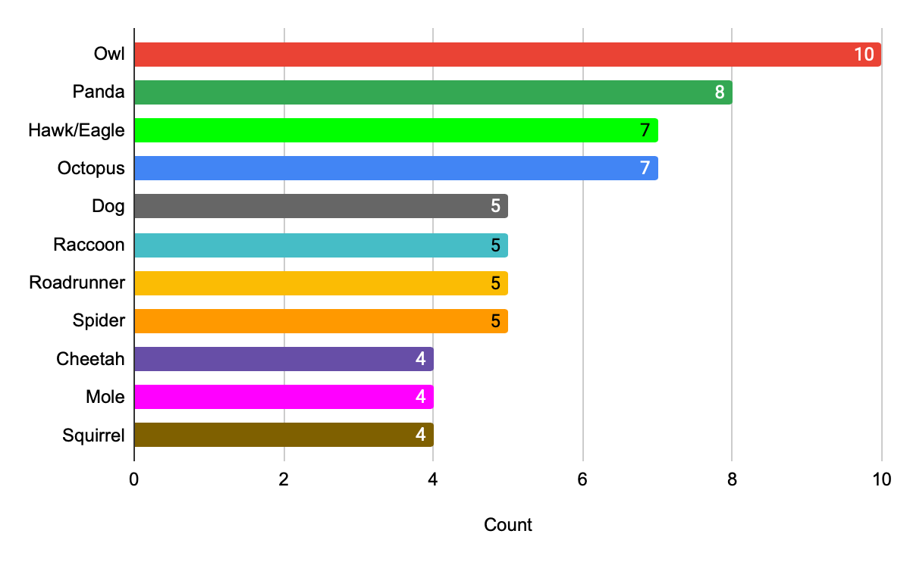
Second Choice

Slide 8
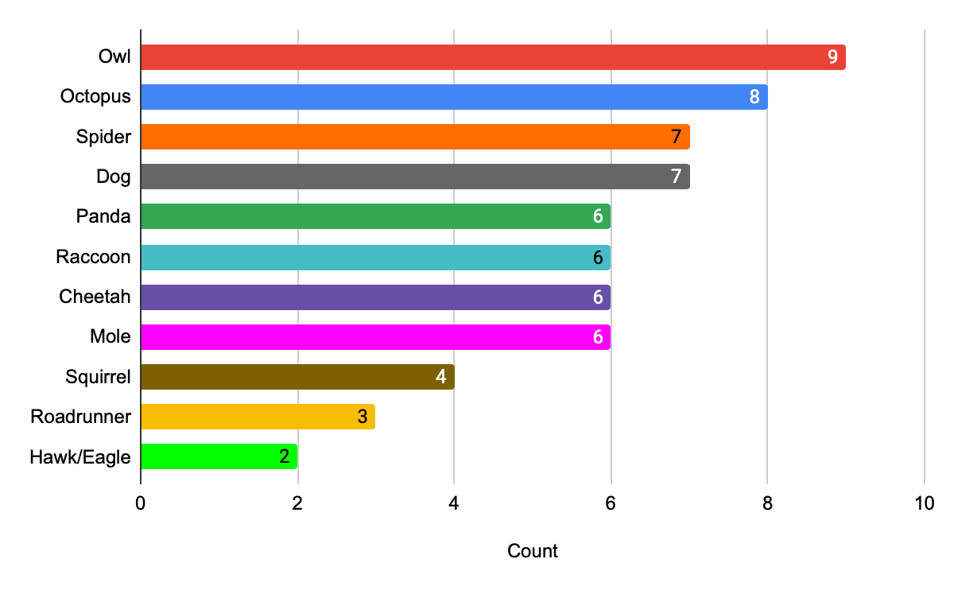
Third Choice

Slide 9
ranked choice voting
If any candidate has >50%, then they win.
Otherwise, remove the lowest tied candidates, and add their voters’ next choice to the respective totals if it’s not already been eliminated.
Continue until a winner is found.

Slide 10
round 1
65 votes, 33 is a majority.
Leader: Octopus 13
Next: Raccoon 9, Spider 7, Panda6, Roadrunner6, Squirrel 6, Mole 5, Cheetah 4
Eliminated: Dog 3, Hawk/eagle 3, Owl 3

Slide 11
round 2
65 votes still active, 33 is a majority.
Leader: Octopus 14
Next: Raccoon 11, Roadrunner 8, Spider 8, Panda 7, Squirrel 7
Eliminated: Cheetah 5. Mole 5

Slide 12
round 3
60 votes still active, 31 is a majority.
Leader: Octopus 15
Next: Raccoon 11, Roadrunner 9, Spider 9
Eliminated: Panda 8, Squirrel 8

Slide 13
round 4
53 votes still active, 27 is a majority.
Leader: Octopus 19
Next: Raccoon 15, Spider 10
Eliminated: Roadrunner 9

Slide 14
round 5
48 votes still active, 25 is a majority.
Leader: Octopus 20
Next: Raccoon 17
Eliminated: Spider 11

Slide 15
round 6
42 votes still active, 22 is a majority.
Leader: Octopus 25 (majority)
Eliminated: Raccoon 17

Slide 16
agenda
Course details.
Mascot vote results.
Team photos.
Relocatable data structures.
Memory mapping a hash table.

Slide 17
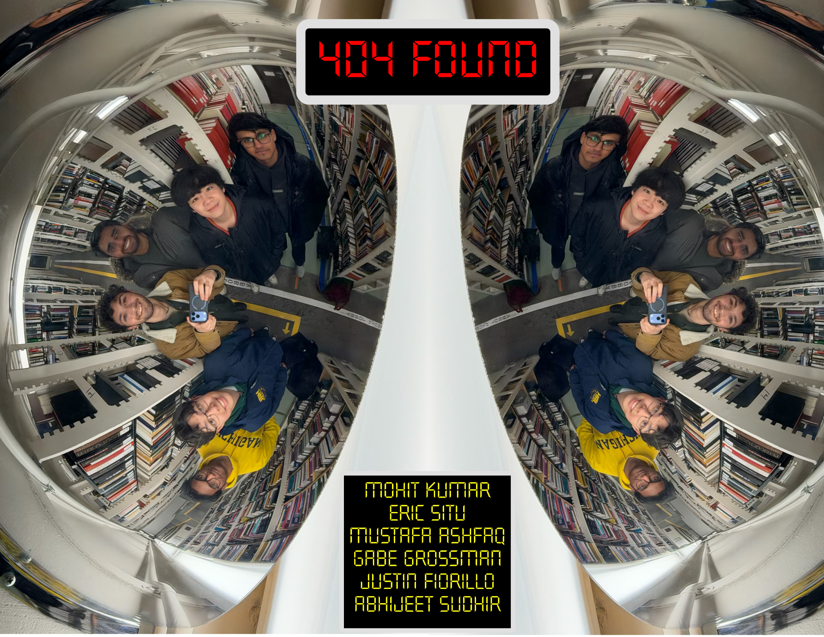

Slide 18


Slide 19


Slide 20
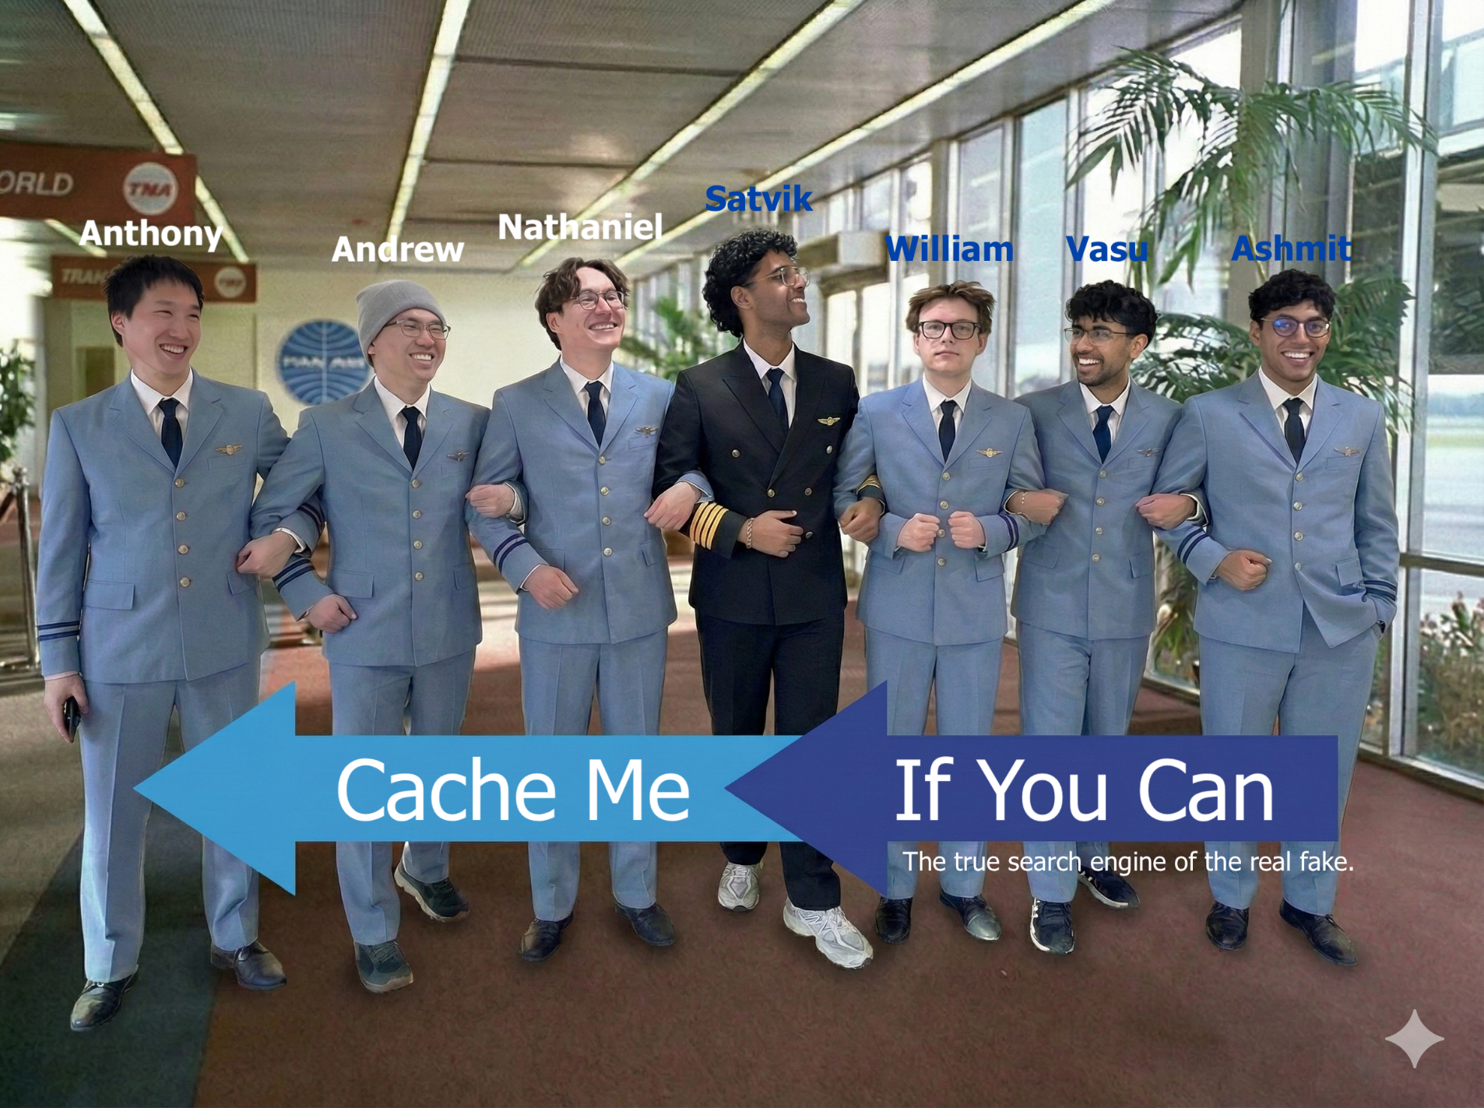

Slide 21
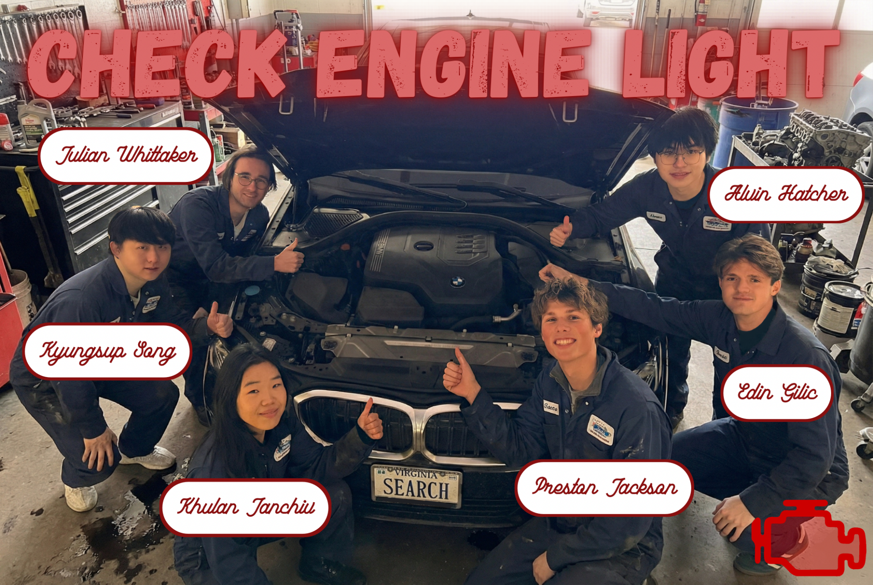

Slide 22


Slide 23


Slide 24
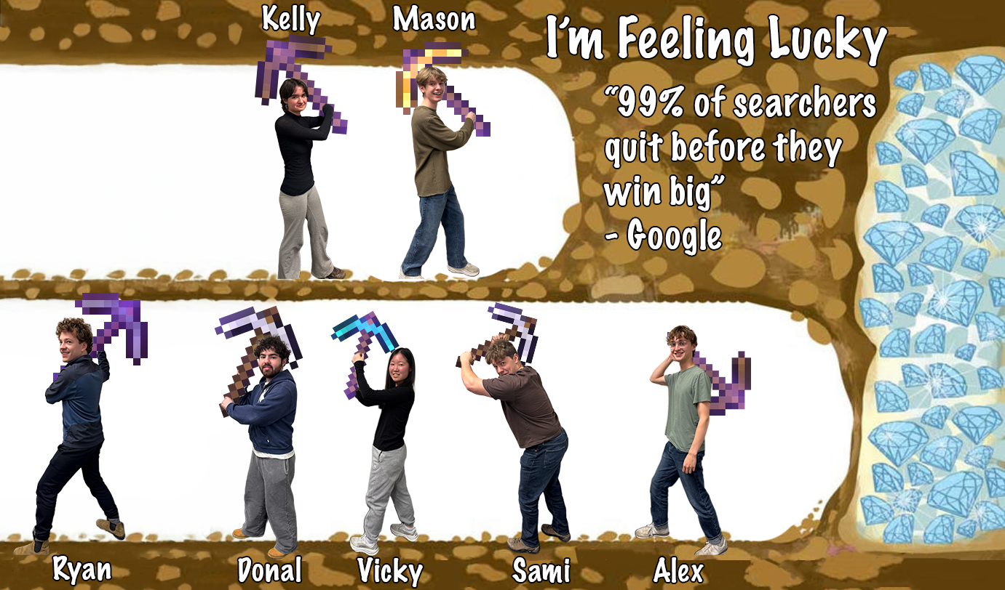

Slide 25


Slide 26
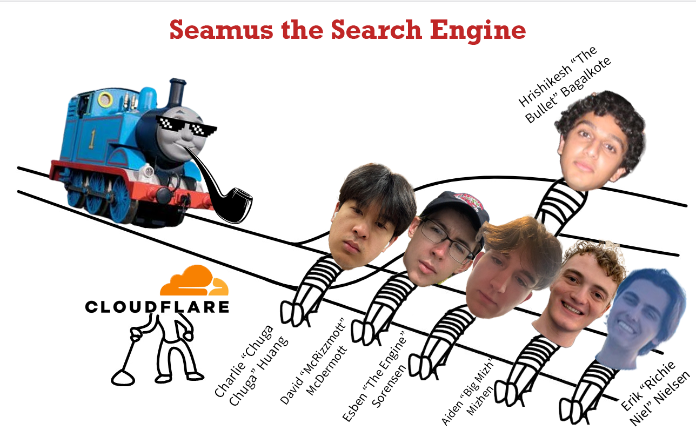

Slide 27
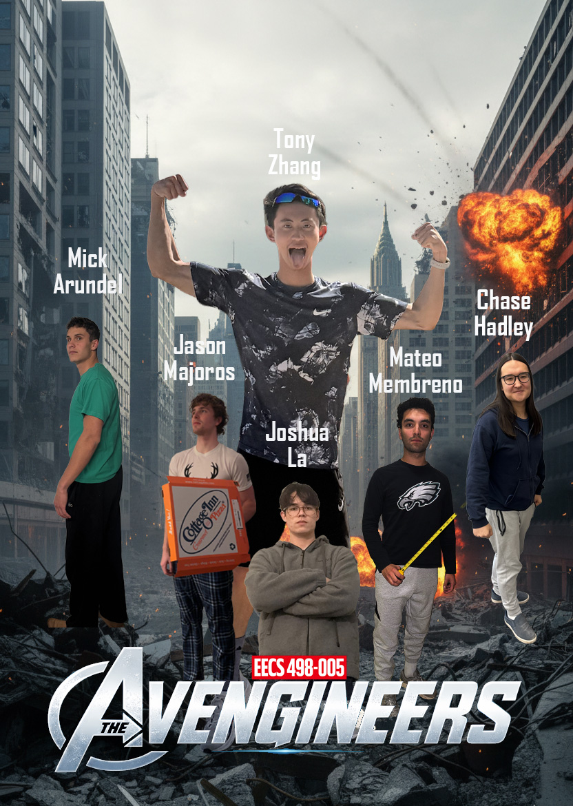

Slide 28


Slide 29


Slide 30
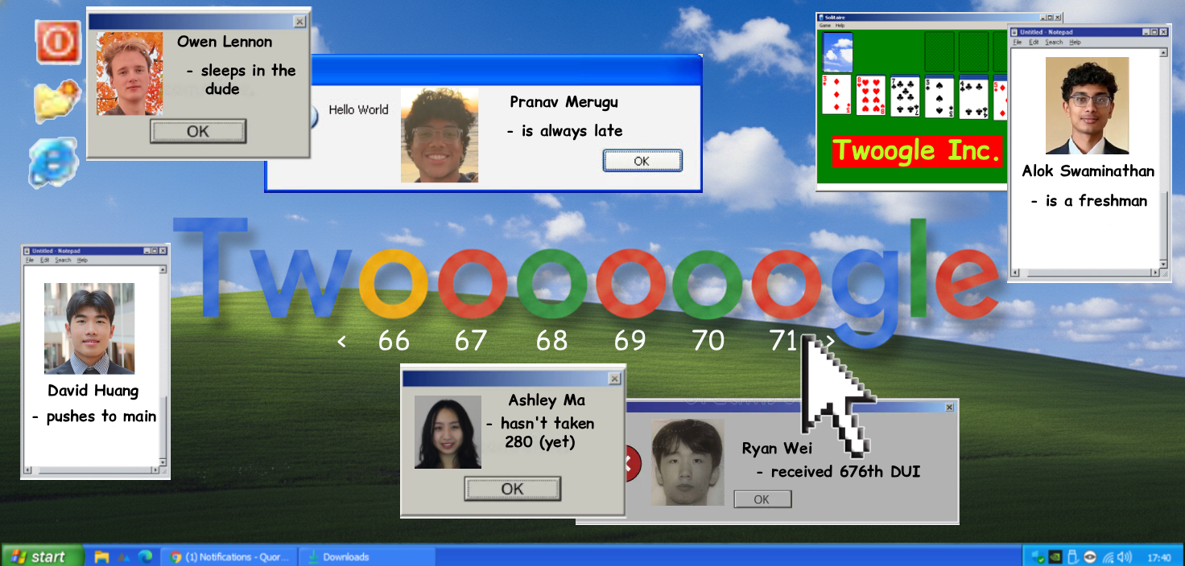

Slide 31
agenda
Course details.
Mascot vote results.
Team photos.
Relocatable data structures.
Memory mapping a hash table.

Slide 32
the problem with pointers
If there are pointers, you can’t just memcopy the whole structure to a new location because it will break the pointers.
6
// Binary tree
struct node
{
int datum;
node *left,
*right;
};
5
8
3
7
9
4

Slide 33
offsets
The solution is to allocate all the nodes within a single block of memory and replace pointers with offsets from the start of the block.
6
// Binary tree
struct node
{
int datum;
int left,
right;
};
5
8
3
7
9
4

Slide 34
agenda
Course details.
Serializing data structures.
Relocatable data structures.
Memory mapping a hash table.

Slide 35
hashing
Create an array of buckets to hold the items you wish to index based on a key field.
Create a simple function that can map the key to a bucket index.
If multiple different keys map to the same bucket, that’s called a collision that we collect on a list.
Search key
Hash function
Index to an array of buckets
List of collisions

Slide 36
HashTable homework
In this assignment, you will build a simple hash table with collisions collected on a linked list.
In the follow-on HashBlob and HashFile assignments, you will:
Serialize your hashtable, including the collisions lists, into a contiguous, minimal-size block of memory with pointers replaced with offsets.
Write it to a file.
In a separate program, memory map the file and use as a live hash table for searching.

Slide 37
HashTable homework
This is leading up to how we will build the index on disk but memory-map it for running queries.

Slide 38
A search engine index is typically a set of files
Master index
Index chunk
Index chunk
Index chunk
Index chunk
…
A master index
Configuration settings
Frontier
List of index chunks
Each index chunk
List of URLS
Inverted word index

Slide 39
The inverted word index
Dictionary
Posting list
Posting list
Posting list
…
Posting list
A posting list
Common Header
Type-specific data
Index
Post
Post
Post
…
Sentinel
An individual post
Delta from previous post
Type-specific data

Slide 40
tcsh-1% g++ HashTable.cpp Common.cpp -o HashTable
tcsh-2% ./HashTable
Usage: HashTable [ -vL ] wordsin.txt
Reads words from wordsin.txt, creates a HashTable
in memory, optimizes it, then searches it for words
read from cin.
-v means verbose output
-L means read whole lines as words
tcsh-3% ./HashTable Testcases/Hamlet.txt
now is the time
36 now
299 is
929 the
time
tcsh-4%

Slide 41
// Simple hash table template.
template< typename Key, typename Value > class Tuple
{
public:
Key key;
Value value;
Tuple( const Key &k, const Value v ) : key( k ), value( v )
{
}
};
template< typename Key, typename Value > class Bucket
{
public:
Bucket *next;
uint32_t hashValue;
Tuple< Key, Value > tuple;
Bucket( const Key &k, uint32_t h, const Value v ) :
tuple( k, v ), next( nullptr ), hashValue( h )
{
}
};

Slide 42
template< typename Key, typename Value > class HashTable
{
private:
// Your code here.
Bucket< Key, Value > **buckets;
size_t numberOfBuckets;
friend class Iterator;
friend class HashBlob;
public:
Tuple< Key, Value > *Find( const Key k, const Value initialValue )
{
// Search for the key k and return a pointer to the
// ( key, value ) entry. If the key is not already
// in the hash, add it with the initial value.
// Your code here.
return nullptr;
}

Slide 43
Tuple< Key, Value > *Find( const Key k ) const
{
// Search for the key k and return a pointer to the
// ( key, value ) enty. If the key is not already
// in the hash, return nullptr.
// Your code here.
return nullptr;
}

Slide 44
void Optimize( double loading = 1.5 )
{
// Modify or rebuild the hash table as you see fit
// to improve its performance now that you know
// nothing more is to be added.
// Your code here.
}
// Your constructor may take as many default arguments
// as you like.
HashTable( )
{
// Your code here.
}
~HashTable( )
{
// Your code here.
}

Slide 45
class Iterator
{
private:
friend class HashTable;
// Your code here.
Iterator( HashTable *table, size_t bucket, Bucket<Key, Value> *b )
{
// Your code here.
}
public:
Iterator( ) : Iterator( nullptr, 0, nullptr )
{
}
~Iterator( )
{
}
:
};

Slide 46
Iterator begin( )
{
// Your code here.
}
Iterator end( )
{
// Your code here.
}
};

Slide 47
// Common code used by the various hashing sample applications.
using Hash = HashTable< const char *, size_t >;
using Pair = Tuple< const char *, size_t >;
// Build a HashTable of strings and numbers of occurrences, given a vector
// of strings representing the words. You may assume the vector and the
// strings will not be changed during the lifetime of the Hash.
// You may add additional parameters but they must have defaults in
// Common.h.
// Caller is responsible for deleting the Hash.
Hash *BuildHashTable( const vector< string > &words )
{
// Your code here.
return nullptr.
}

Slide 48
void CollectWordsIn( int argc, char **argv, vector< string > &words )
{
:
// Open wordsin.txt
ifstream wordsin( *argv );
argc--;
assert( wordsin.is_open( ) );
string word;
:
while ( wordsin >> word )
{
words.push_back( word );
sumLengths += word.size( );
}
:
}

Slide 49
// Sample HashTable application
void Usage( )
{
cout <<
"Usage: HashTable [ -vL ] wordsin.txt\n"
"\n"
"Reads words from wordsin.txt, creates a HashTable\n"
"in memory, optimizes it, then searches it for words\n"
"read from cin.\n"
"\n"
"-v means verbose output\n"
"-L means read whole lines as words\n";
exit( 0 );
}

Slide 50
using Hash = HashTable< const char *, size_t >;
using Pair = Tuple< const char *, size_t >;
void Search( const Hash *hashtable )
{
// Search the HashTable for words read from cin.
string word;
while ( cin >> word )
{
const Pair *p = hashtable->Find( word.c_str( ) );
cout << ( p ? p->value : 0 ) << " " << word << endl;
}
}

Slide 51
int main( int argc, char **argv )
{
if ( argc < 2 )
Usage( );
vector< string > words;
CollectWordsIn( argc, argv, words );
if ( optVerbose )
{
:
}
else
{
Hash *hashtable = BuildHashTable( words );
hashtable->Optimize( );
Search( hashtable );
delete hashtable;
}
}

Slide 52
HashBlob
In the next homework, you’ll serialize your hash table into a relocatable blob that can be written to a file.

Slide 53
tcsh-1% g++ --std=c++17 HashBlob.cpp Common.cpp -o HashBlob
tcsh-2% ./HashBlob
Usage: HashBlob [ -L ] wordsin.txt [ blobfile ]
Reads words from wordsin.txt, creates a hashblob,
then searches it for words read from cin.
If blobfile is specified, it writes the hashblob
into the blobfile.
-v means verbose output
-L means read whole lines as words
tcsh-3% ./HashBlob Testcases/Hamlet.txt
now is the time
36 now
299 is
929 the
32 time
tcsh-4%

Slide 54
class HashBlob
{
// This will be a hash specifically designed to hold an
// entire hash table as a single contiguous blob of bytes.
// Pointers are disallowed so that the blob can be
// relocated to anywhere in memory
// The basic structure should consist of some header
// information including the number of buckets and other
// details followed by a concatenated list of all the
// individual lists of tuples within each bucket.
public:
static const size_t HashBlobMagic = 0x4e69636f6c65,
CurrentVersion = 0;
size_t MagicNumber,
Version,
BlobSize,
NumberOfBuckets,
Buckets[ Unknown ];
// The SerialTuples will follow immediately after.
:
};

Slide 55
tcsh-11% ./HashBlob Testcases/Hamlet.txt MyBlob.bin
tcsh-12% g++ --std=c++17 HashFile.cpp Common.cpp -o HashFile
tcsh-13% ./HashFile
Usage: HashFile [ -v ] blobfile
Map the blobfile into memory and then search it for words
read from cin.
-v means verbose output
tcsh-14% ./HashFile MyBlob.bin
now is the time
36 now
299 is
929 the
32 time
tcsh-15%

